Slide 1
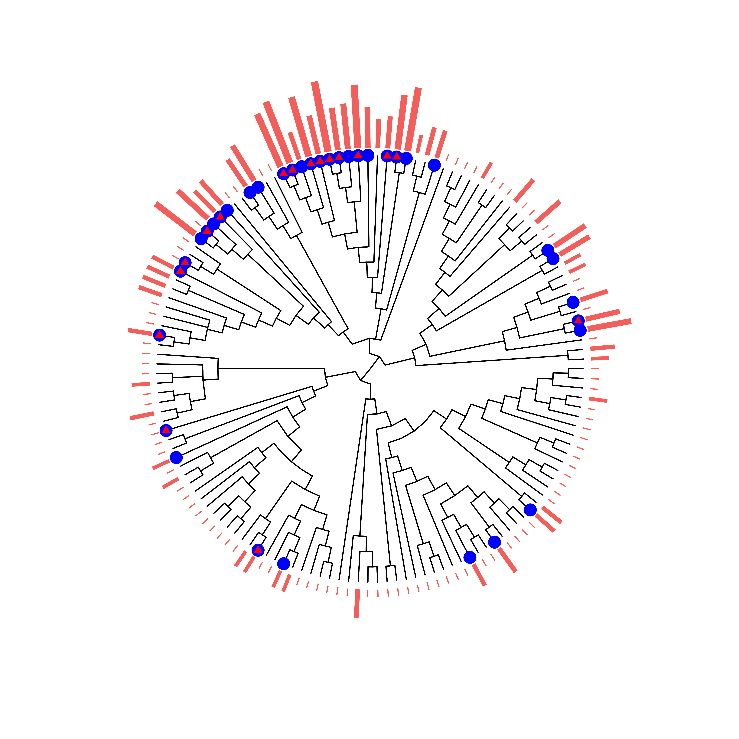
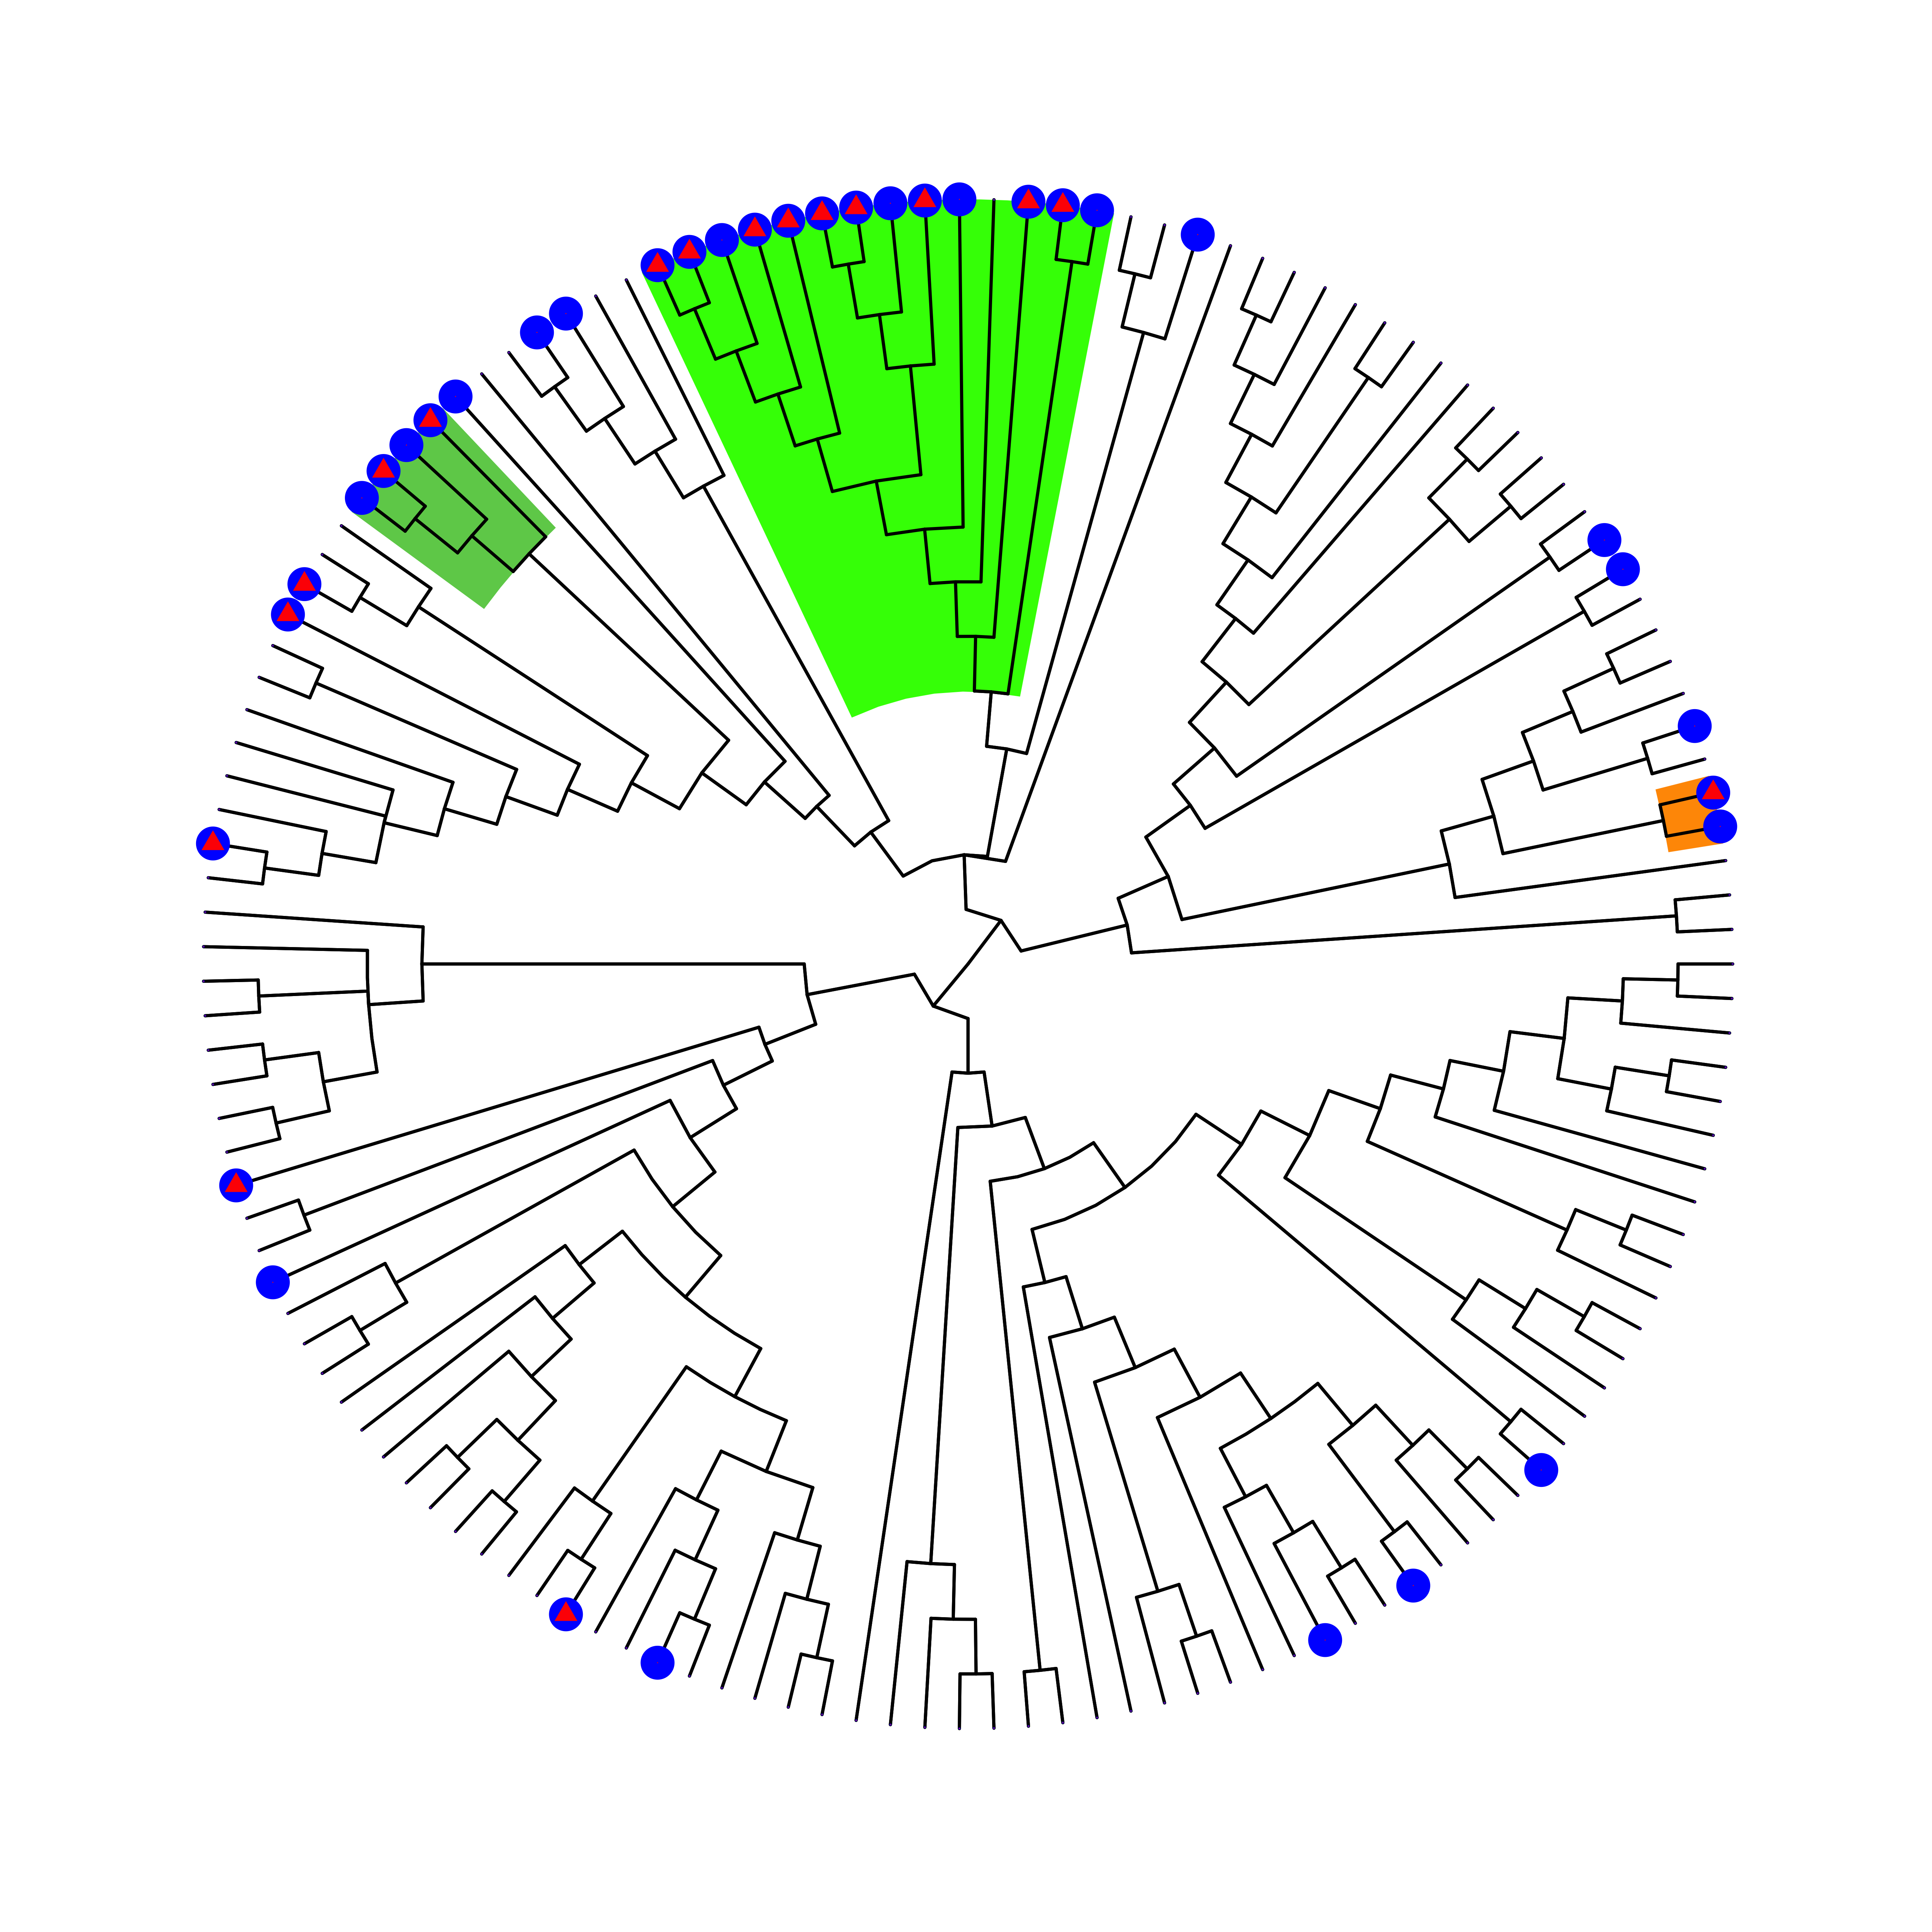
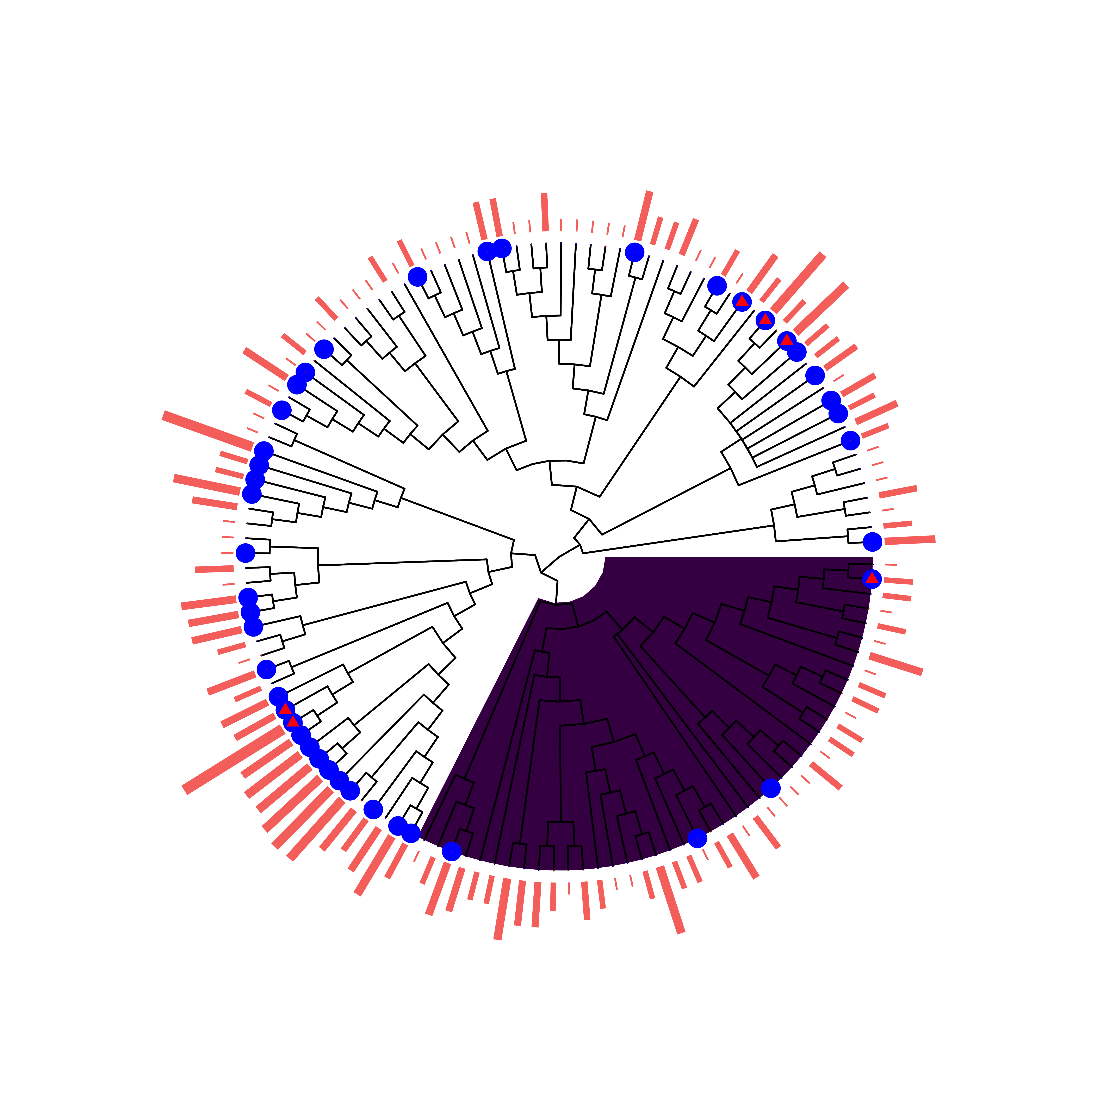
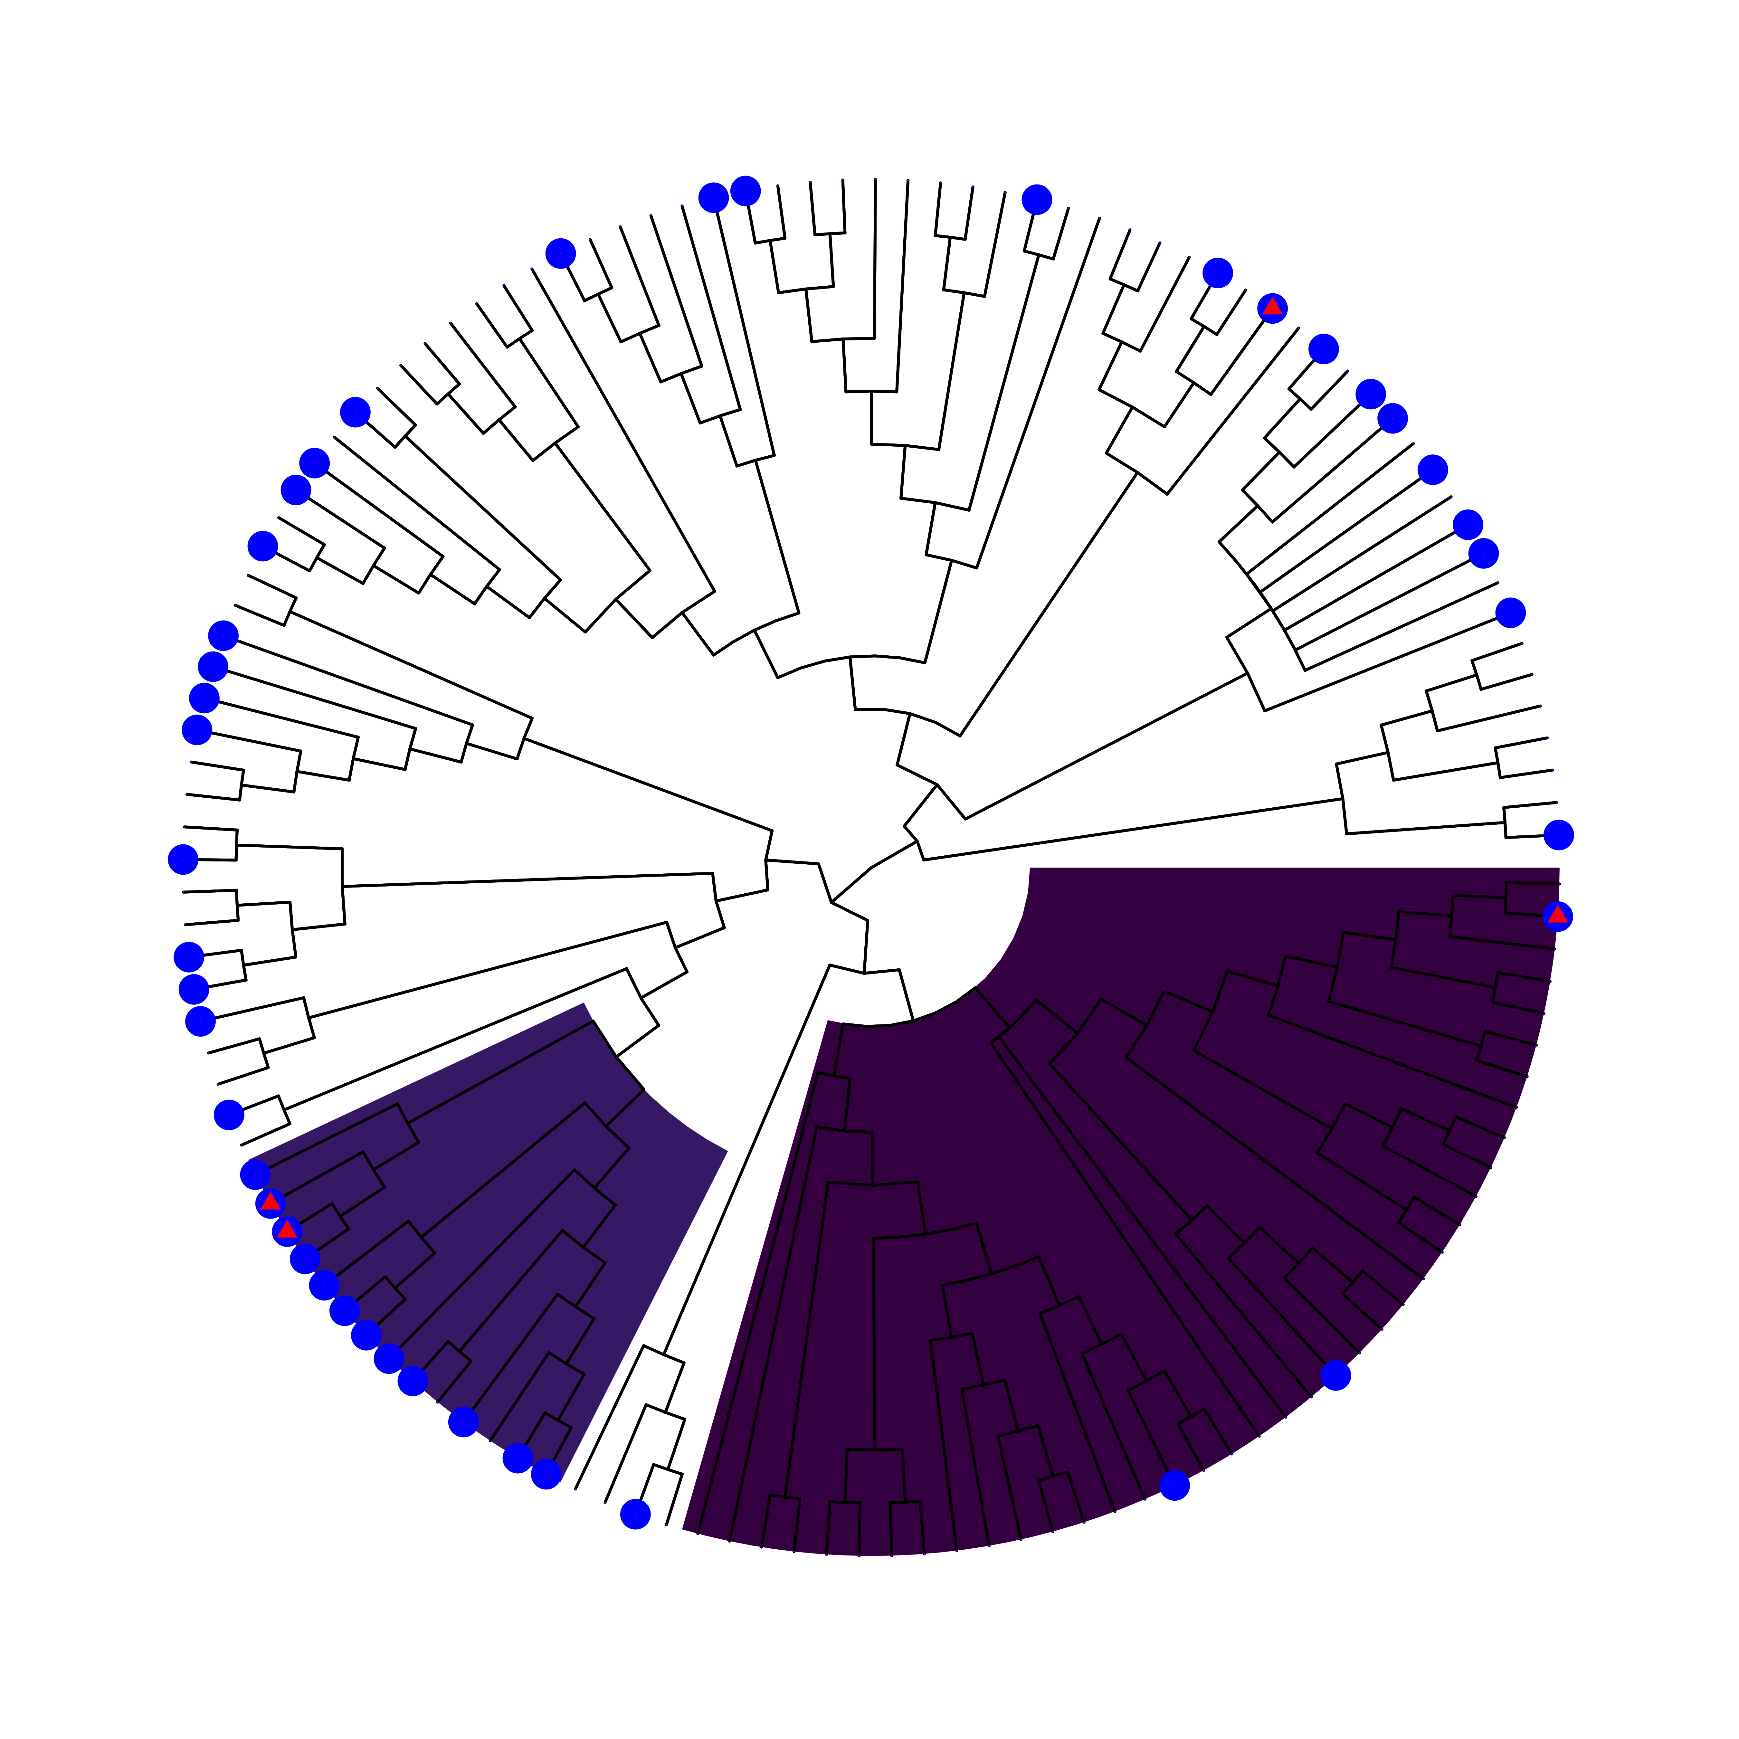

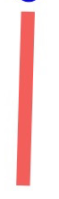
Ignoring Sampling Effort
Controlling for Sampling Effort
Henipavirus
Factor # | Name | Tax. Level | Species | % Species Positive
1 | Pteropodinae | Subfamily | 14 | 93
2 | Rousettus | - | 4 | 100
3 | Hipposideros | Genus | 2 | 100
- | Paraphyletic Remainder | - | 119 | 14
Factor # | Name | Tax. Level | Species | % Species Positive
Factor # | Name | Tax. Level | Species | % Species Positive
1 | Pteropodidae | Family | 14 | 86
2 | Rhinolophoidea | Superfamily | 39 | 8
- | Paraphyletic Remainder | - | 79 | 35
Factor # | Name | Tax. Level | Species | % Species Positive
1 | Rhinolophoidea | Superfamily | 43 | 9.3
- | Paraphyletic Remainder | - | 89 | 43.8
Filovirus
Key
AB +
PCR +
1+ ln(Sampling Effort)

